Slide 1
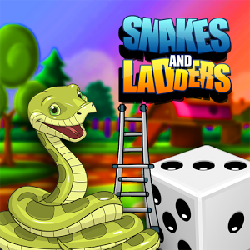

fttttL
Snakes And Ladders
fttttLLearn with Fun

Slide 2
Introduction
Get ready to re-live your all time favorite game Snake and Ladder . The perfect Education board game that assures you won’t get bored. The game goal is very simple to climb up to 100 and each move their will be one question . You will have to answer of these questions correctly. If you give correct answer of that question you will get some score and according to this you will move into the next number and if your answer will be wrong then you will not get the score but player will continue his game. If the player comes in snake block and gives the correct answer the snake will not bite else the player will move down to tail block. Also, when player visit’s ladder block and gives correct answer he will climb up or else will remain in same block.
Hope for best, the player who will give correct answers of maximum questions in minimum time those will win the game and will become champion.

Slide 3
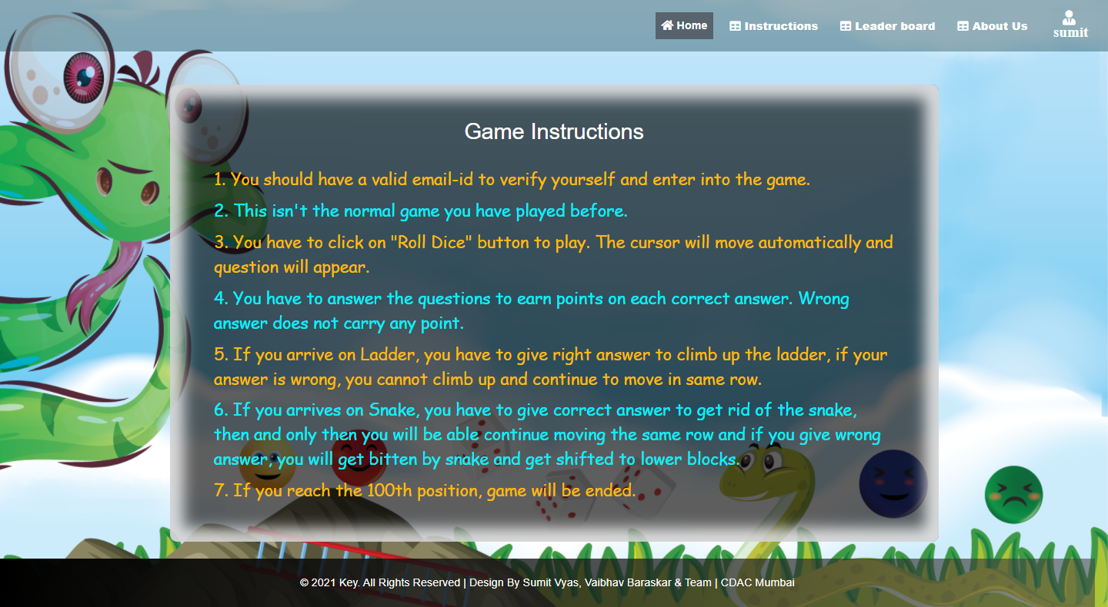
Instructions..

Slide 4
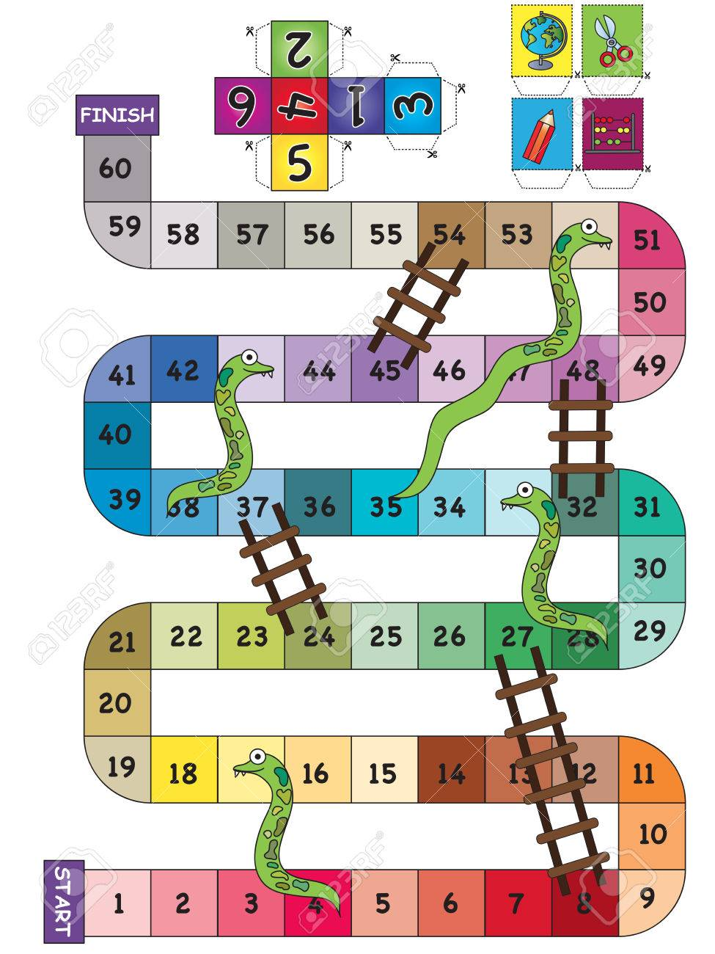
Technology
JSP
Servlet
Hibernate

Slide 5
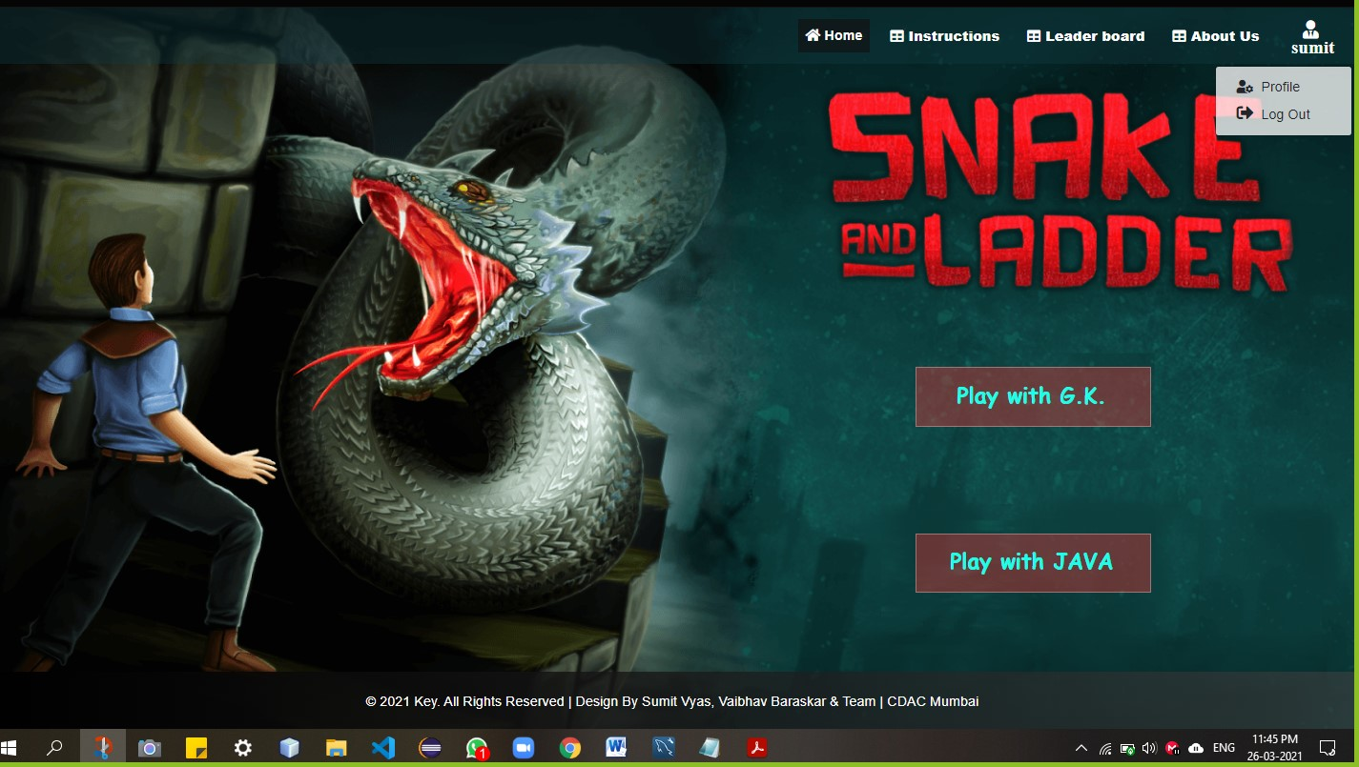
Screenshots
HOME PAGE

Slide 6
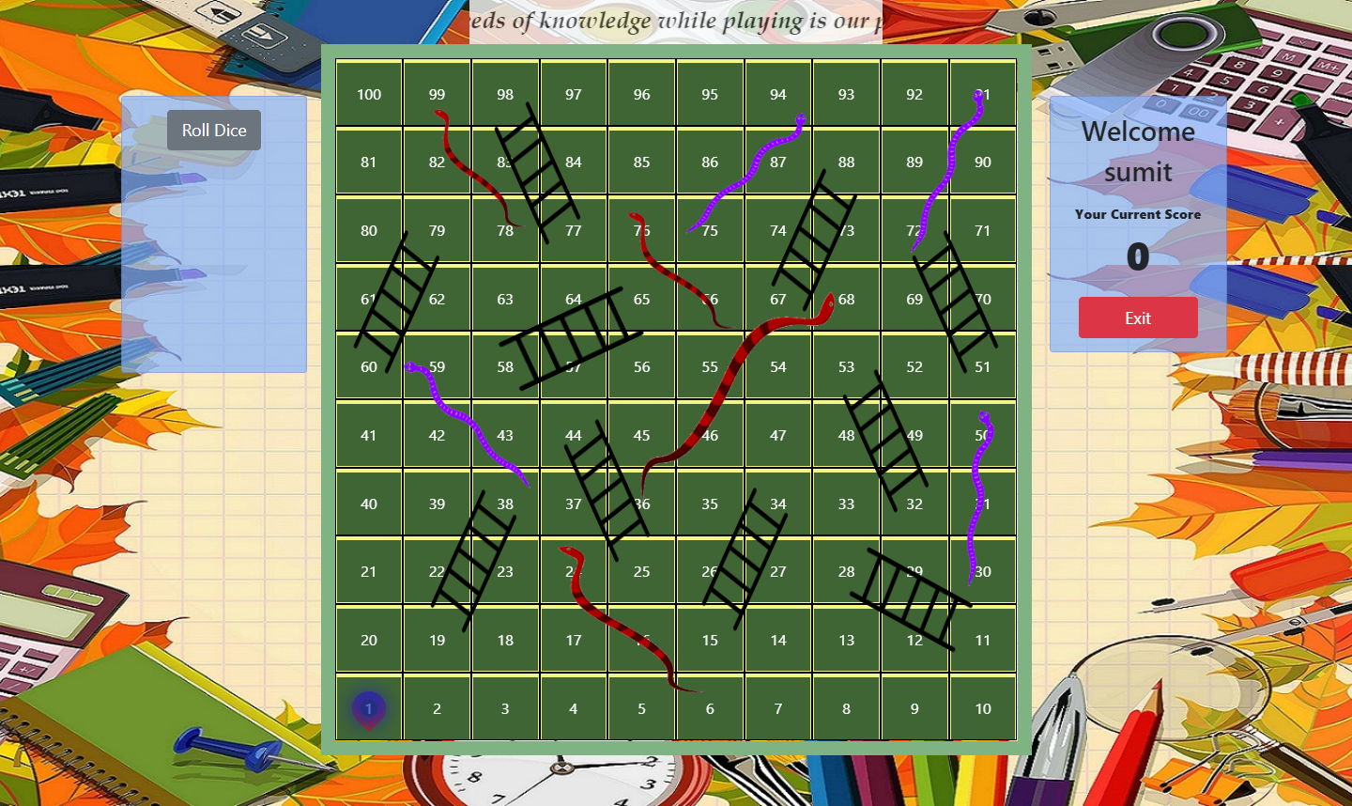
Screenshots
game Board

Slide 7
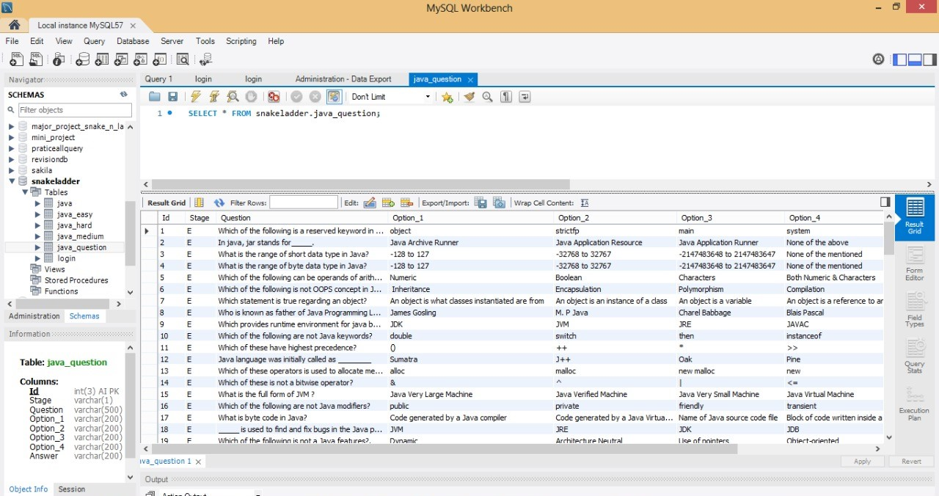
Screenshots
Database

Slide 8

Screenshots
SIGN UP

Slide 9
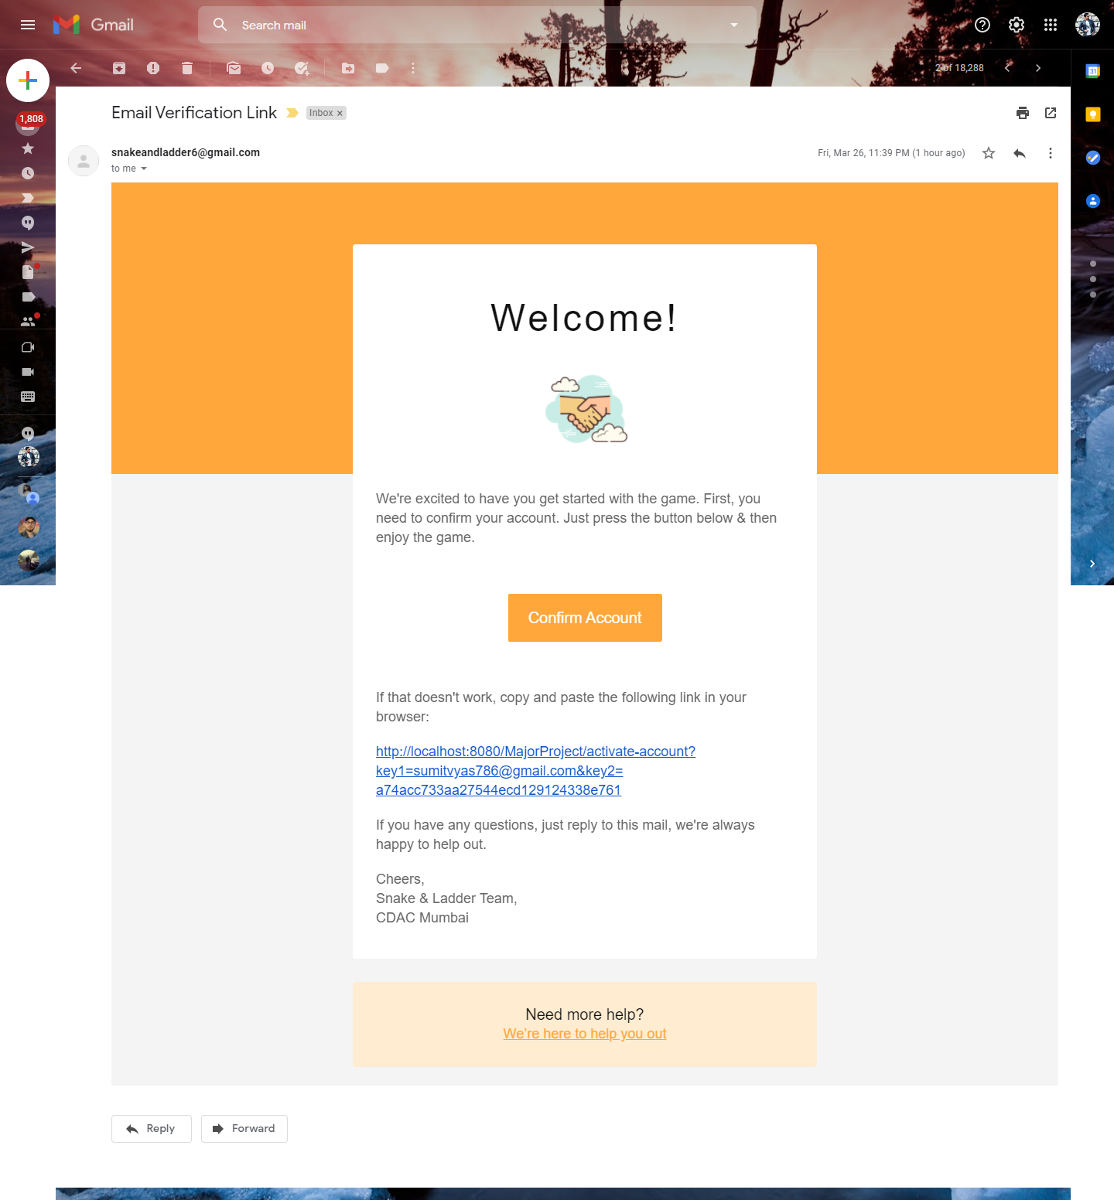
Screenshots
EMAIL REGISTERATION

Slide 10
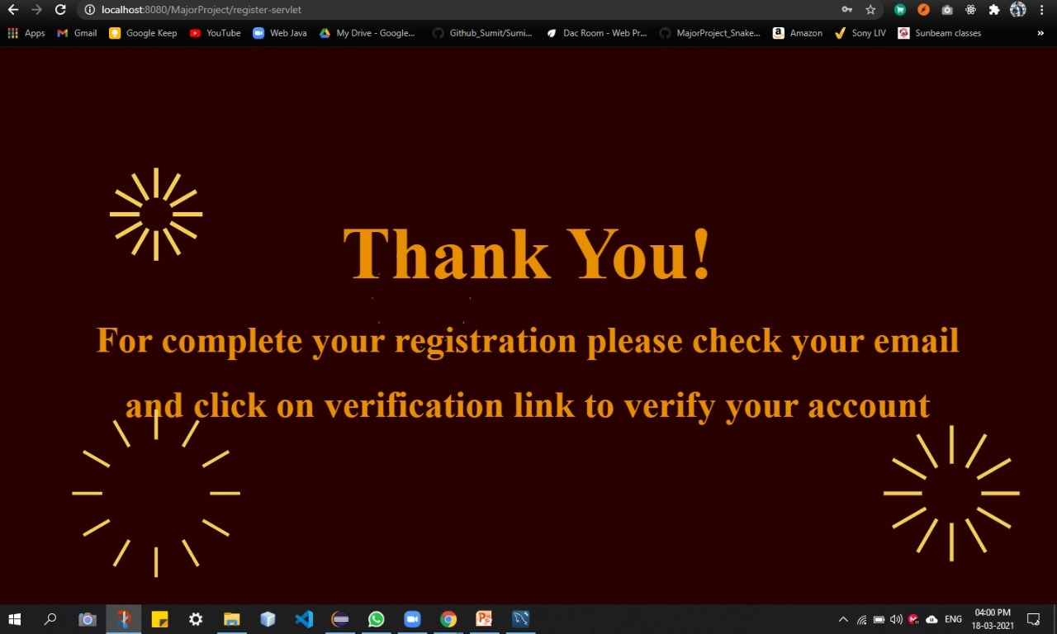
Screenshots
REGISTERATION SUcCESS

Slide 11
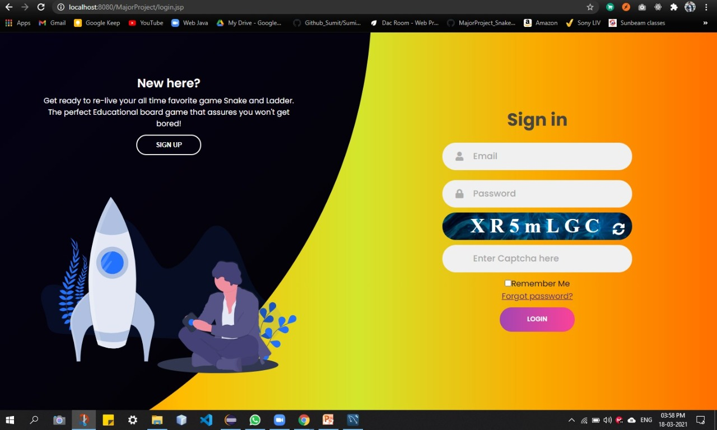
Screenshots
SIGN IN

Slide 12

Screenshots
FORGOT PASSWORD

Slide 13
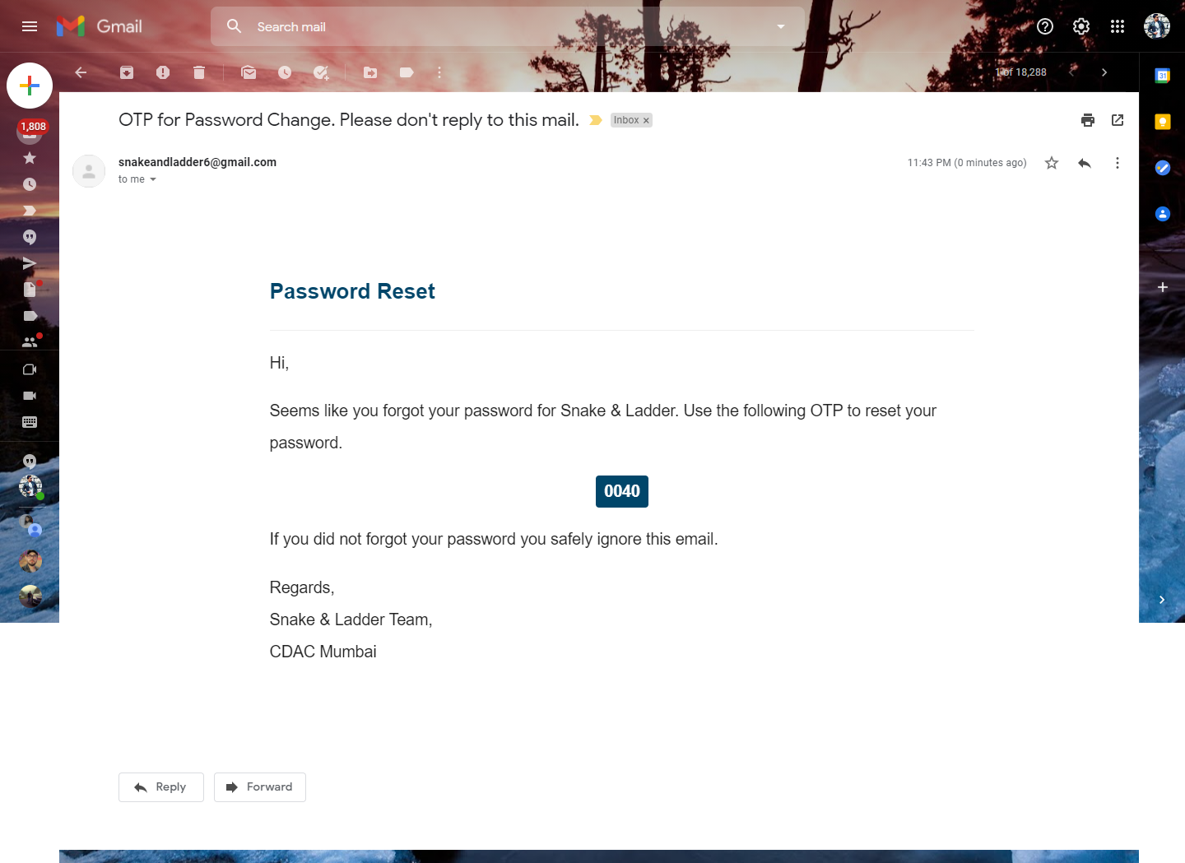
Screenshots
OTP

Slide 14

Screenshots
OTP VERIFICATION

Slide 15
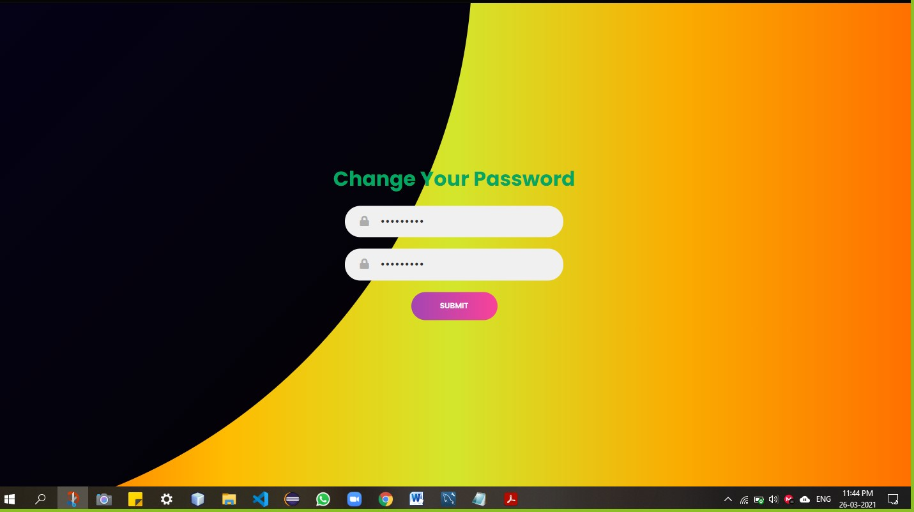
Screenshots
PASSWORD CHANGE

Slide 16
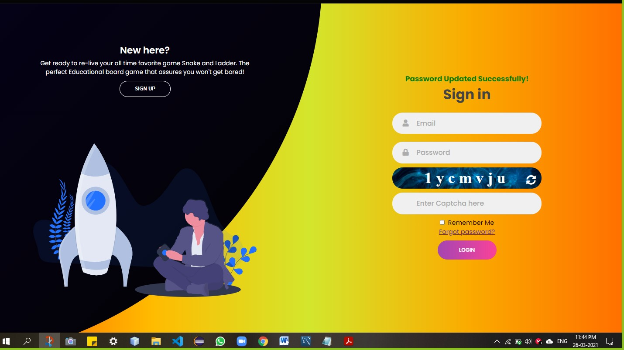
Screenshots
PASSWORD CHANGED

Slide 17
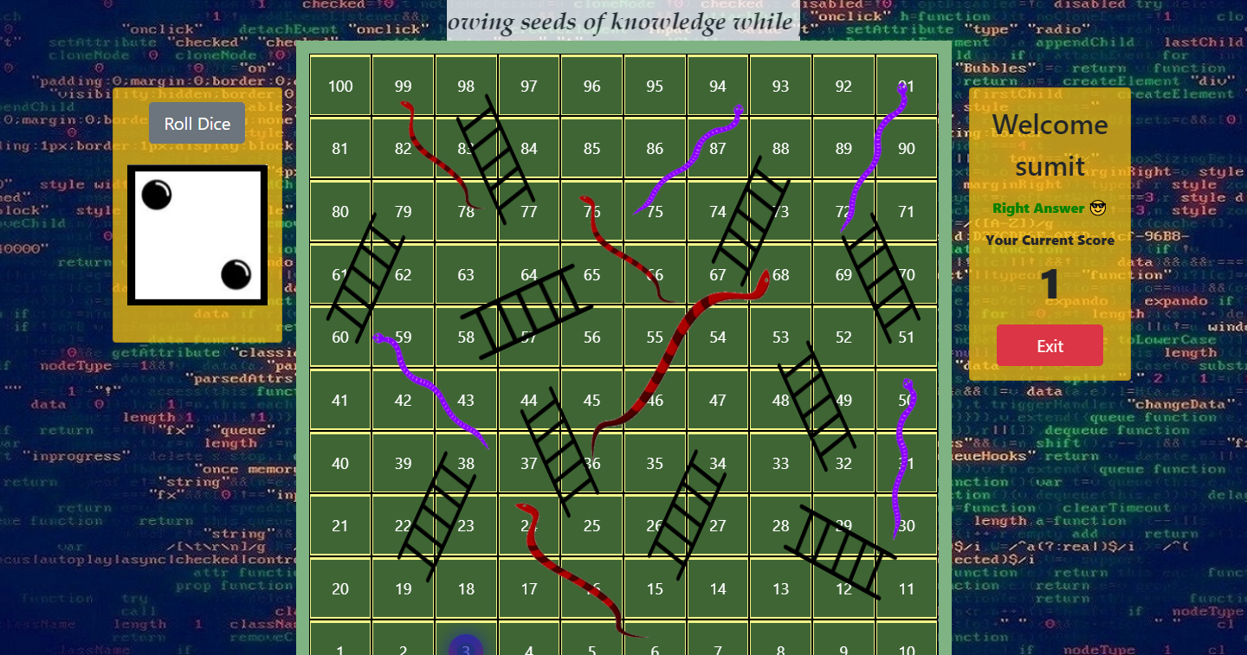
Screenshots
GAME PLAY

Slide 18
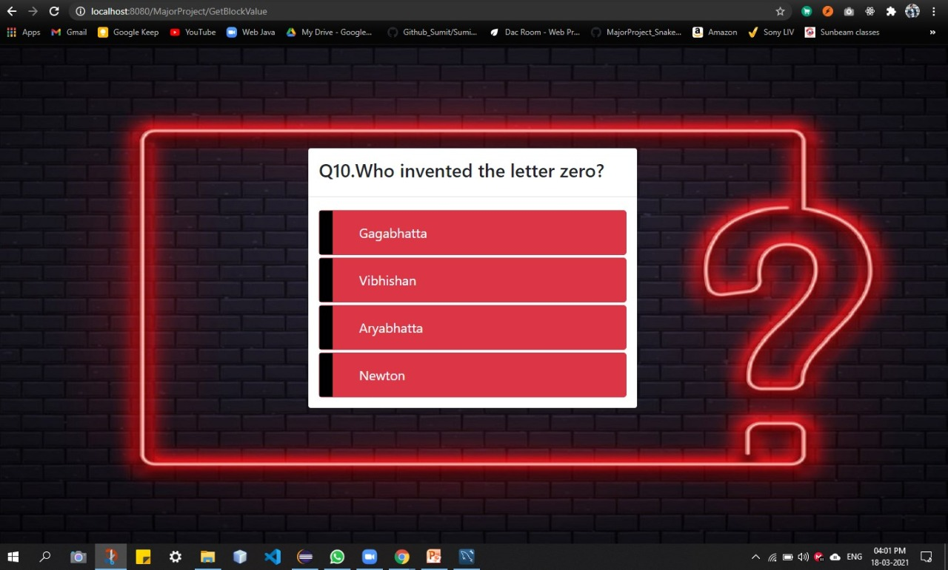
Screenshots
QUESTION PAGE

Slide 19
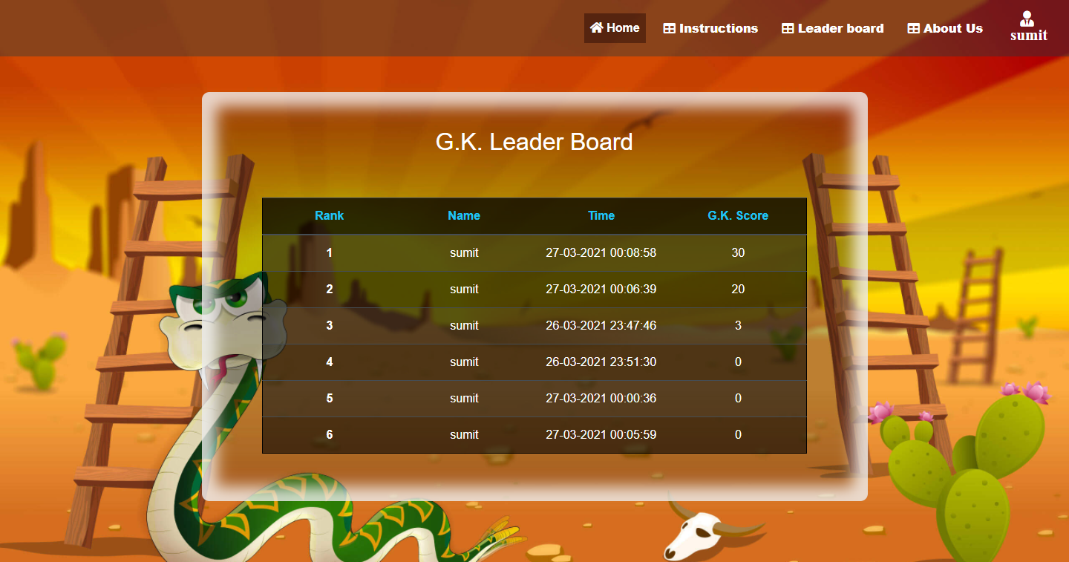
Screenshots

Slide 20
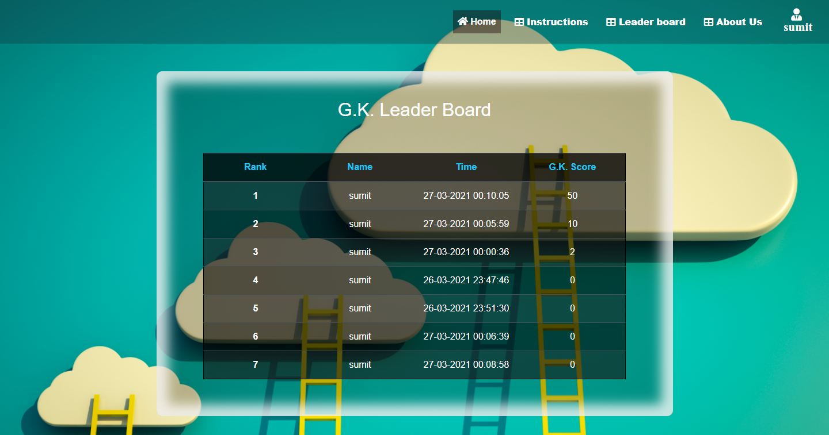
Screenshots

Slide 21
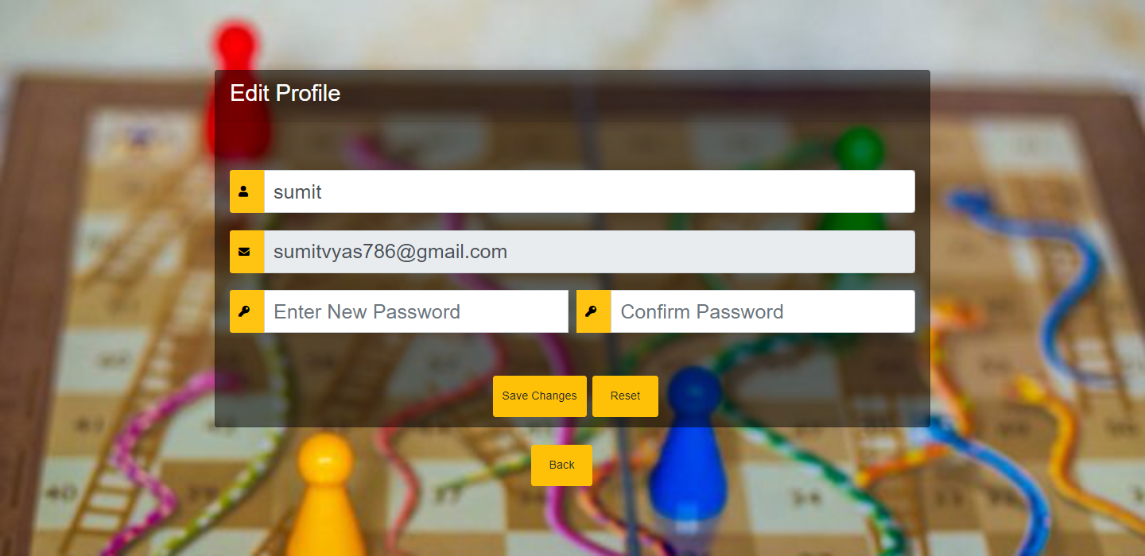
Screenshots

Slide 22
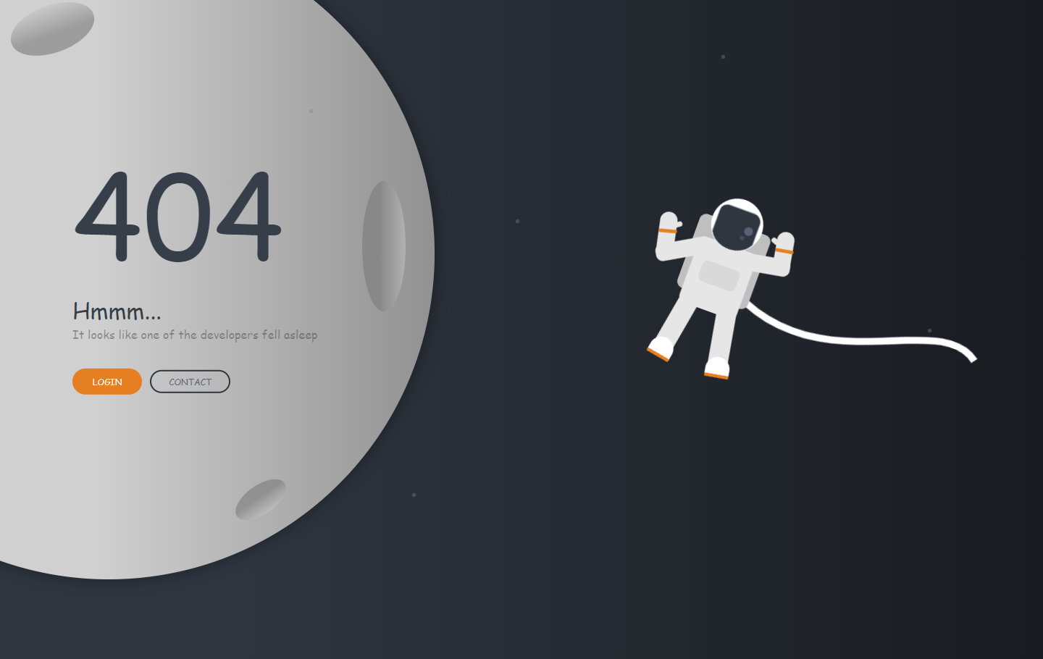
Screenshots

Slide 23

Thank You

